Slide 1
Web-based Singletrack Trail Information System & Geolocator
SIE 509 – Fall 2015: Final Project
Joel whitney (M.S. Spatial information science and engineering)
Notes:
When I first starting thinking about projects for this class I wanted find an idea that was novel and could also be immediately useful for myself and others.
I was biking a lot of the singletrack mountain bike trails in the Bangor area and I wasn’t very familiar with the Orono/Old Town trail network.
I decided to start bringing my bike with me on the days I came to campus so I could explore the trails after my classes.
The first time I went out for a ride I remember I ended up getting turned around or lost numerous times. On the second trip, I ended up coming out of the woods at the mill in Old Town and biked pavement back.
I thought to myself, if I can get this turned around on a relatively small trail network than it must be extremely hard to navigate through larger trail systems.
Since I, and most other bikers, carry their phones on their person it makes sense to have a system that not only aids in traversing trail systems, but also can provide trail information to its users.

Slide 2
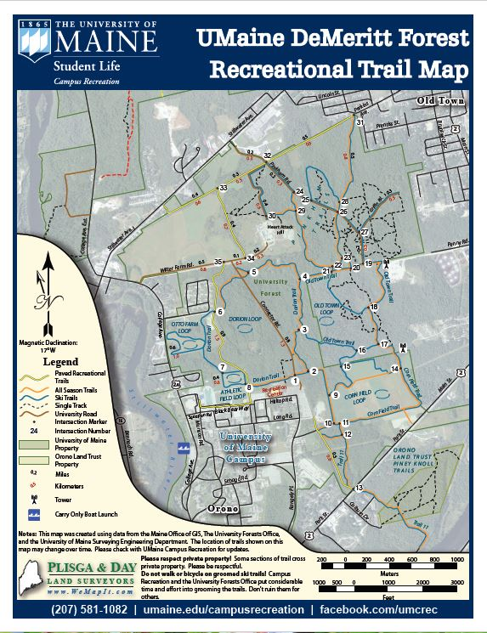
What is the current solution?
Current solution is PDF/paper map
You cannot get any information from PDF map
Map ends at PDF boundaries
Managing multiple trail PDFs is inconvenient
UMaine Map
Not up to date with single track trails
Geo-reference info not maintained in PDF
Notes:
The traditional solution for users of trail is to reference a trail map of the geographic area.
Most management groups of trail systems have some sort of map that trail users can use to see the layout of the trails.
A lot of the times this is in the form of a paper map at a kiosk or on signage at the trail entrances.
Sometimes you can find PDF versions of these maps available online for use.
Very rarely, albeit becoming more frequent nowadays, will you see PDFs with the georeferencing maintained so that the PDFs can be used for navigation.
Even in these rare cases, the user is still unable to directly interact with the map to acquire additional information about the trails besides location.
Furthermore, for bikers who visit multiple trail systems, keeping track of multiple PDF maps is a major inconvenience.
Based on the above issues, it was clear to me that a better system should exist for managing location and trail system information.

Slide 3
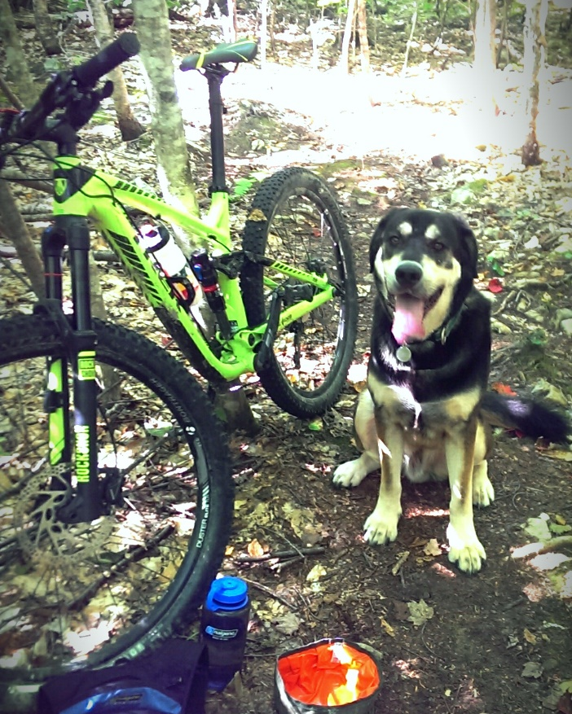
Overview
Make local database of single track bike trails around UMaine
Easily extendable to other systems
Collect data:
GPS tracks
Local trail names
International Mountain Bike Association trail ratings
Other general information (management, pets, etc.)
Present in an easy to use way
Focus is on mobile platform
Notes:
My plan early on was to make a central database of all of the trail networks that have single track bike trails in the area.
I decided to start with the Orono trail systems first and then work on the Bangor systems if time permits.
Never would have got done otherwise. Talk about problems later on.
This forced me to consider making a system that could be easily extendable to other systems.
When using my system I wanted the users to be able to view numerous attributes about the trails. So I had to collect data, such as: local trail names, IMBA trail ratings, land management, pets allowed, etc.
I wanted to take this database and make it available on an easy to use mobile web map that automatically fixes to the persons current position using the phones built in GPS.

Slide 4
Hardware/Software Used
Desktop
ArcMap 10.3 - Most of the project completed and maintained using ArcMap
QGIS 2.12 - Initial handling of GPX files and exporting GeoJSON files
Java OpenStreetMap Editor - Downloading and uploading data from/to OpenStreetMap
ODK Aggregate – Database client for GeoODK Collect data running on my Google App Engine.
Python 3.4 - Wrote script to reformat the linestrings in a CSV into WKT format
Notepad++ - HTML/CSS/JS editor
HTC One
GeoODK Collect – Collect singletrack trail paths and information
Strava – Collect all biking trail paths
PDF Maps – Used location testing of georeferenced PDF map
Garmin 60cX GPS – Collect all biking trail paths
Notes:
But before I start into my project, here is some of the hardware and software I used.

Slide 5
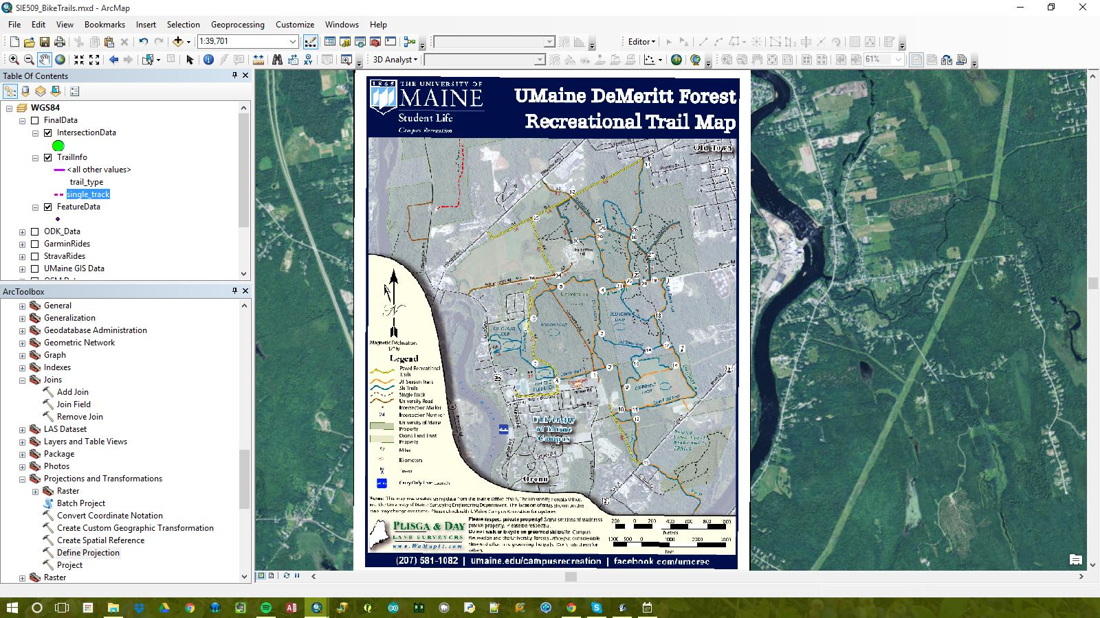
Step 1: Collect existing data
Georeferenced PDF in project
Notes:
From my initial research, it looked like there were a handful of PDF maps available for the trails in the area. Most of the maps were a number of years old and the data was not easily accessible.
The University had their PDF posted online so I was able to download that and georeference it into my project.
I figured since they have a map then they must have the data as well.

Slide 6
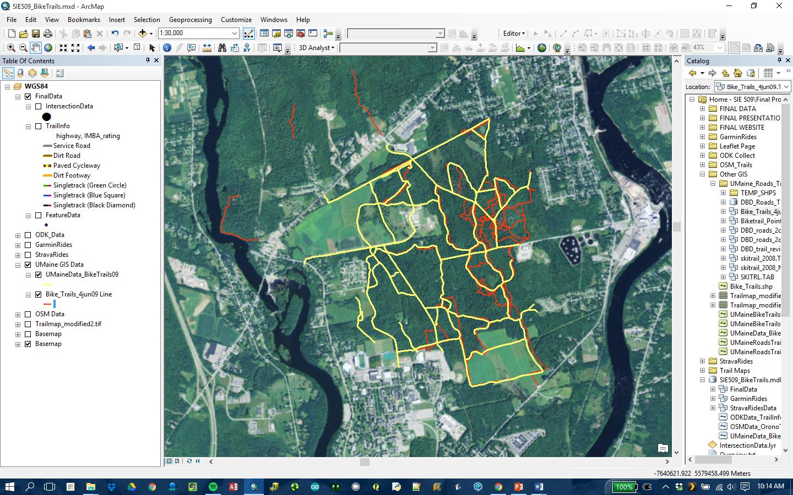
Step 1: Collect existing data
The trail data acquired from UMaine of the trails (from 2009)
Notes:
After emailing number people I was directed to the Forestry Department and was able to acquire some trail data that was used to create the PDF map from the previous slide.
The data that was used to create the trail maps was from 2009 and was incomplete, especially for the singletrack trails.
At this point I knew I was going to have to collect my own data to get a complete dataset of the DeMeritt Forest.

Slide 7
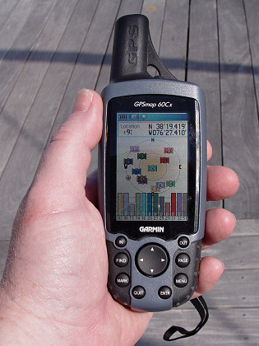


Step 2: Collect my own data
Data collection methods:
Strava (GPS tracks)
Garmin handheld (GPS tracks)
GeoODK Collect (Trail info, GPS tracks, Intersection Info)
Notes:
Initially, I started by using Strava, a biking app, to record rides that I went on.
After a few attempts, I realized that the combination of collecting data on my mobile GPS under tree cover made it extremely difficult to get consistent data.
The general flow of the trails was consistent and I figured the more data I could collect the easier it would be to build centerlines from the data.
Ultimately, I would use multiple modes of collection to try and get the most data to work with as possible.
This would mean using the data I already had from the University as well as collecting data through: the Strava app on my mobile phone, my Garmin 60cx handheld GPS, and GeoODK Collect.

Slide 8
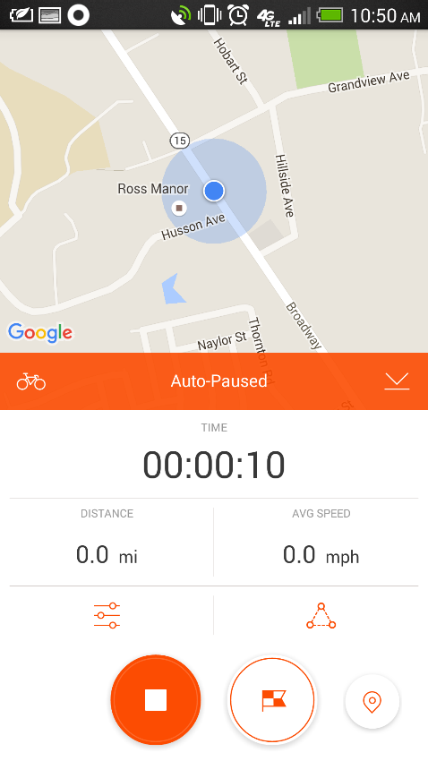
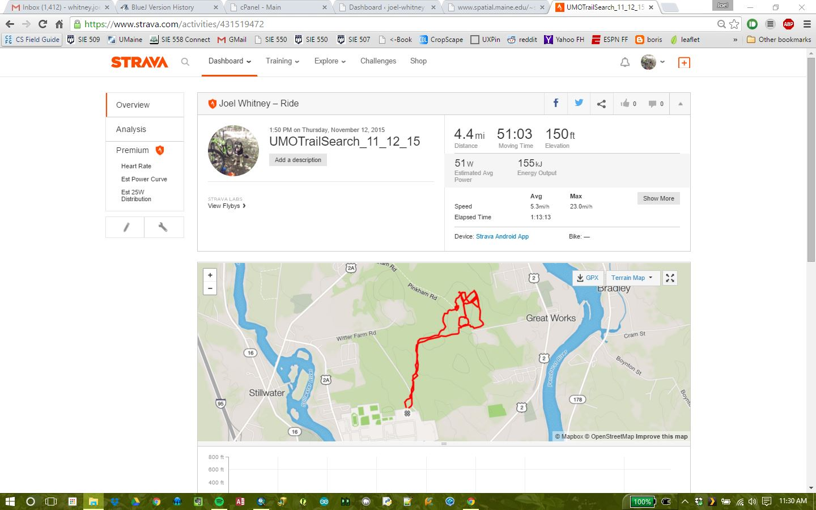
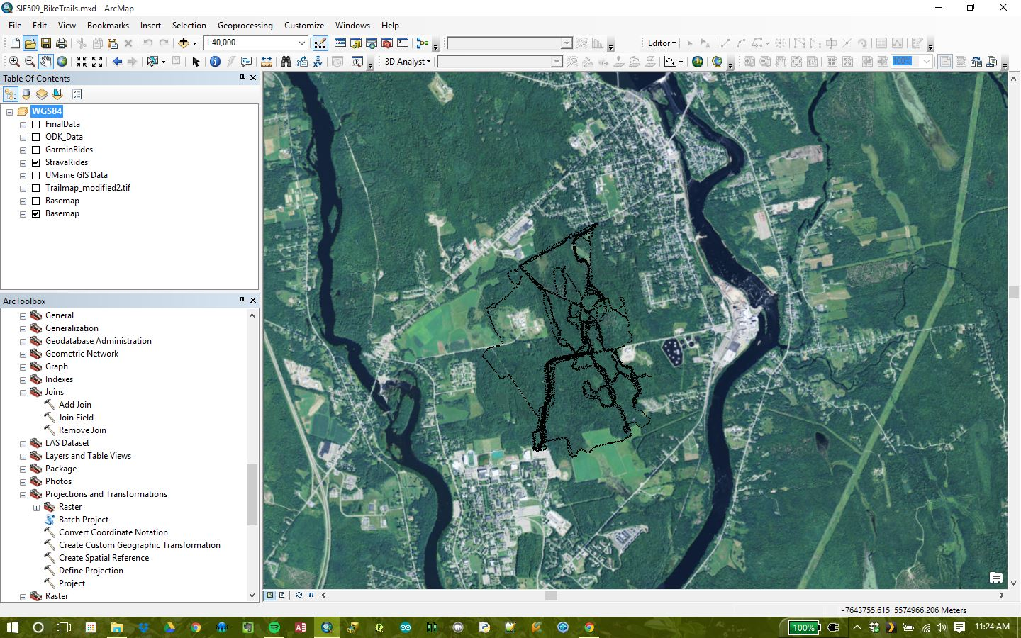
Step 2a: Strava app
Strava data on Strava website
Final Output of Strava data imported as GPX
Single GPX tracks merged into a single SHP
Notes:
Collecting the data using the Strava biking app and the Garmin 60cx was essentially the same process.
When I departed from the Recreation Center parking lot I would turn on my GPS and the start the Strava app on my phone. I would also start the tracking on my Garmin handheld.
At the end of the ride I would stop the Strava app and save the ride as an easily identify track, such as ‘UMOTrailSearch_10_02_15’. I would also stop the tracking on my Garmin and save the track so the SD card.
I was then able to go online on my Strava account and download the GPX file for each biking session. For my Garmin handheld, I just had to mount the SD card on my computer and I could extract the GPX from each session.
In total, I biked 51.8 miles collecting data using the Strava app. For some reason, ArcMap did not like the GPX files from my two sources so I imported them into QGIS first and then exported them as shapefiles that I could then add into my geodatabase.

Slide 9
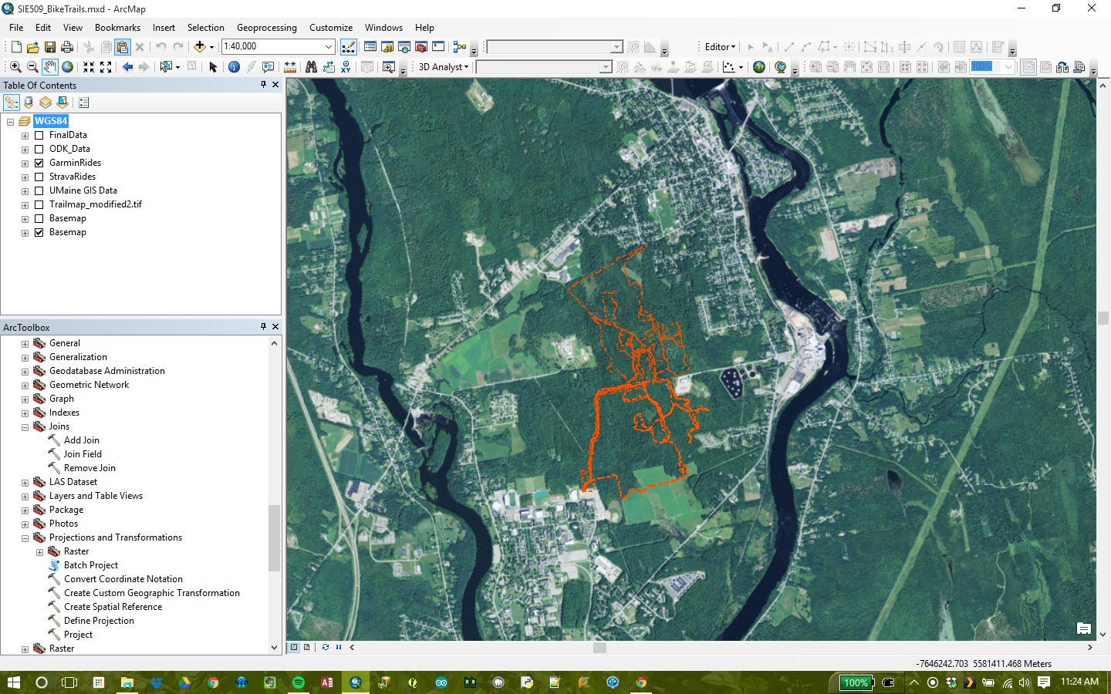
Step 2b: Garmin Handheld
Final Output of Garmin data imported as GPX
Notes:
Here are the results of the Garmin recordings

Slide 10
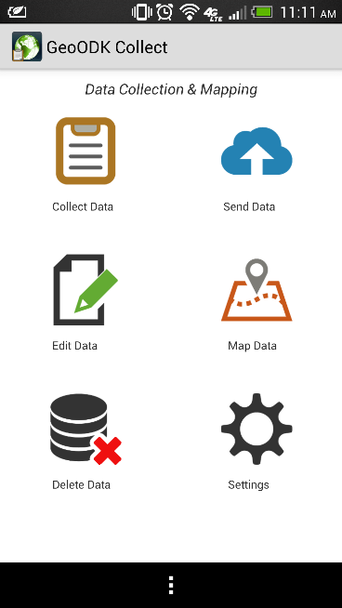
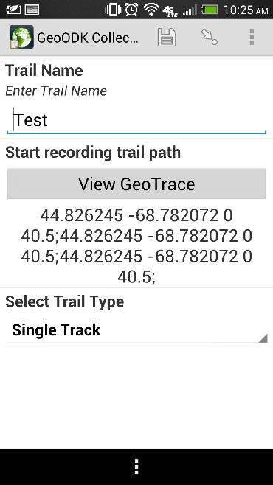
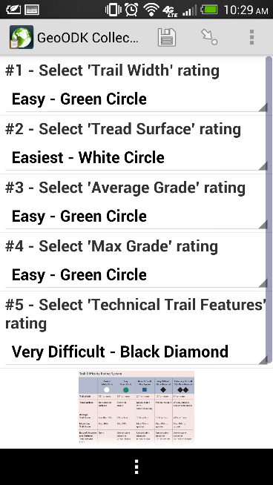
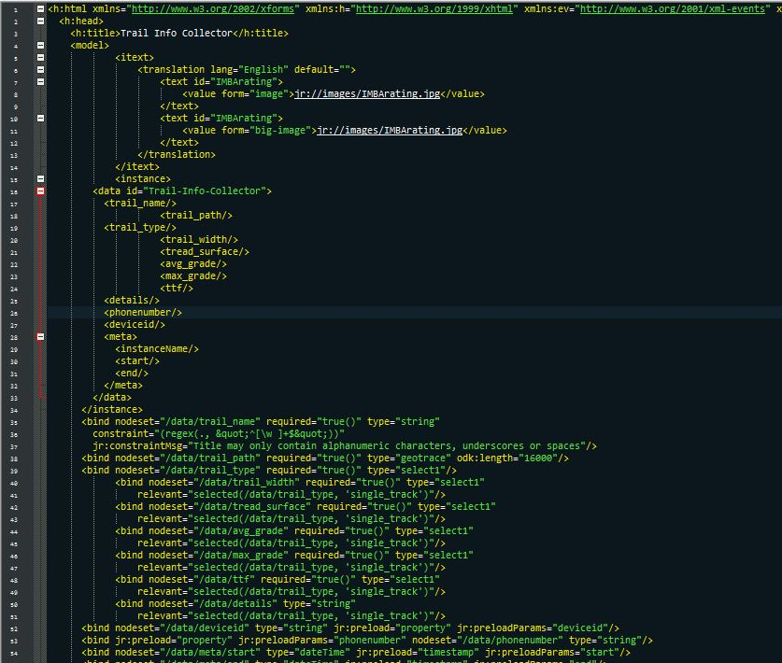

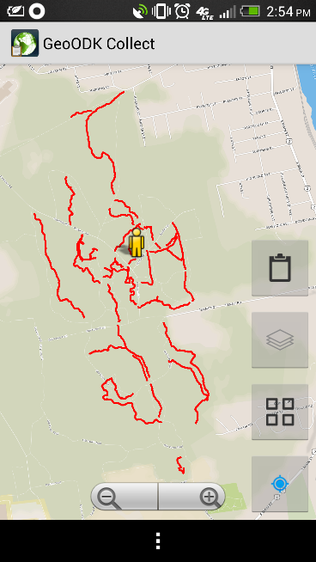
Step 2c: GeoODK Collect (Input)
XML based forms
Notes:
In addition to having accurate paths for each trail, I also wanted to have various trail information for the trails, such as: local trail names, IMBA trail ratings, land management, pets allowed, etc.
This meant I would need to have some sort of data collection method.
I decided to utilize an open source data collection app, called GeoODK Collect, which I had prior experience with.
GeoODK Collect uses XML based forms that the user can fill out on their mobile device and send back to an aggregate server through an internet connection.
This allowed me to collect trail paths and information in the woods and send it back to the server in real time.
I spent some time and programmed two forms that would be used by the app for my data collection: 1) ‘Trail_Info_CollectorV2.xml’ and 2) ‘Feature_Collector.xml’.
The trail info form allowed the user to input data such as: trail name, record the trail path (at 1 sec intervals), trail type, various IMBA rating categories, and add additional comments if desired.
The feature collector form let the user input location (GPS), feature type, take a picture, and additional comments about the feature.
Although the feature collector form was not used for this system, it could be used to collect locations of important landmarks.

Slide 11
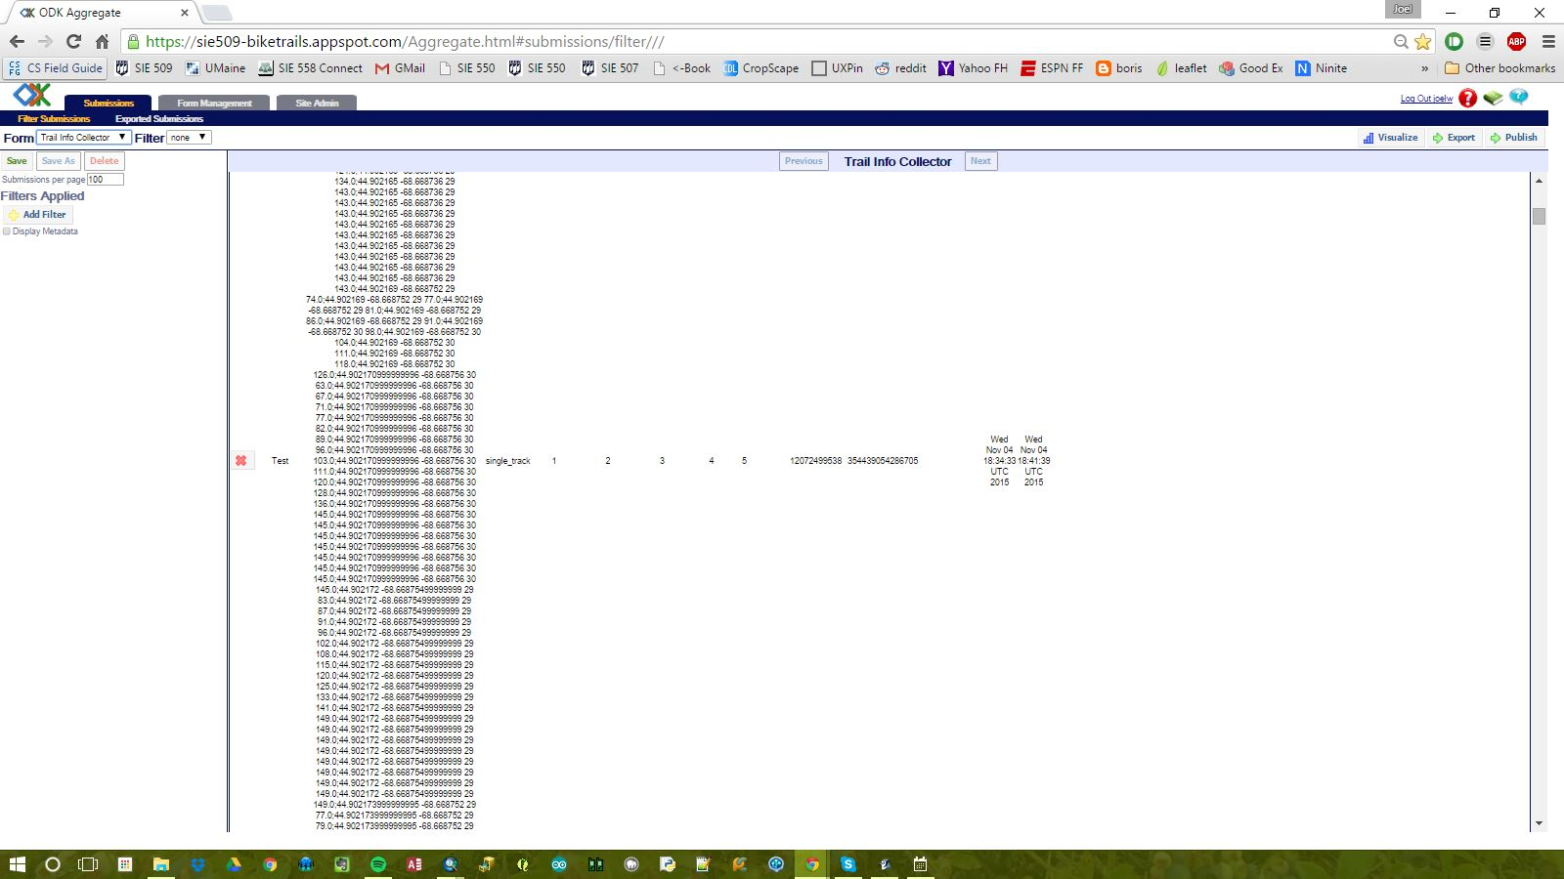
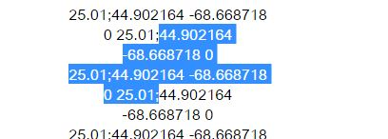
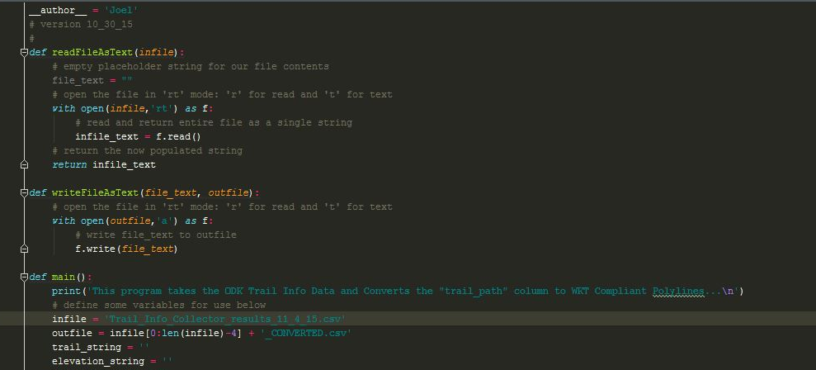
Step 2c: GeoODK Collect (Output)
ODK Aggregate Client:
Running on Google Developer Server
Node format
lat1 lon1 elev1 acc1; lat2 lon2…
NEEDED format (WKT Format) – Python conversion
LINESTRING((lon1 lat1, lon2 lat2,…))
Notes:
The data sent back to the server was sent to an ODK Aggregate client that I hosted on my Google App Engine.
This enables multiple users to send data back to the server simultaneously.
Furthermore, I could sign in to the client and export the data in various formats.
For this project, I exported the records as a csv.
Upon importing the CSV into QGIS I realized that the format of the trail path wasn’t compliant with the WKT format that QGIS wanted the linestrings to be formatted as.
The format of the nodes was exported from the GeoODK app as, ‘lat1 lon1 elev1 acc1; lat2 lon2…’.
In order to be WKT compliant the format would need to be, ‘LINESTRING((lon1 lat1, lon2 lat2,…))’.
My solution was to write a Python script that would iterate through all tuples in the CSV and convert the ‘trail_path’ field to the WKT format and write the new tuple to a new CSV.

Slide 12
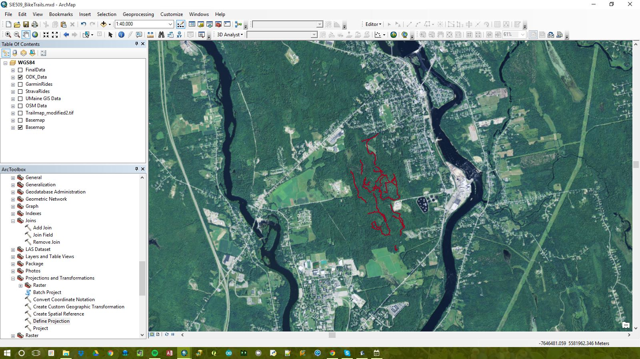
Step 2c: GeoODK Collect (Output)
Final Output of GeoODK Data imported as CSV
Notes:
The final output was a CSV that could be imported into QGIS and then exported as a shapefile that I could then add into my geodatabase.
Here is the output.

Slide 13
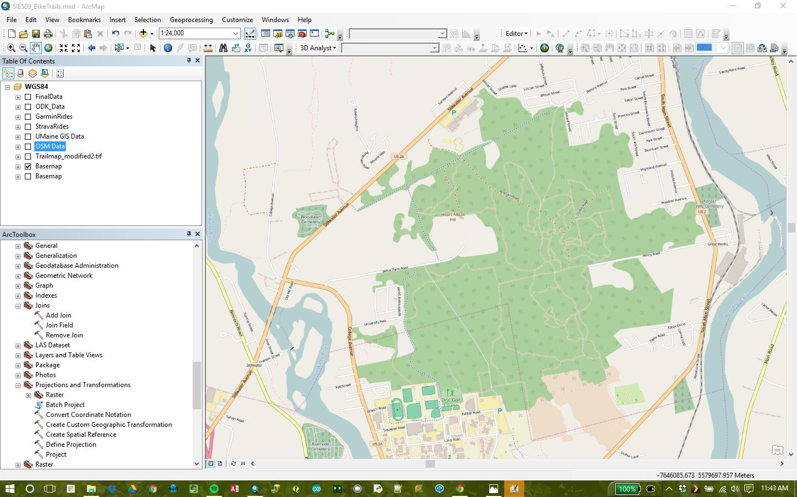
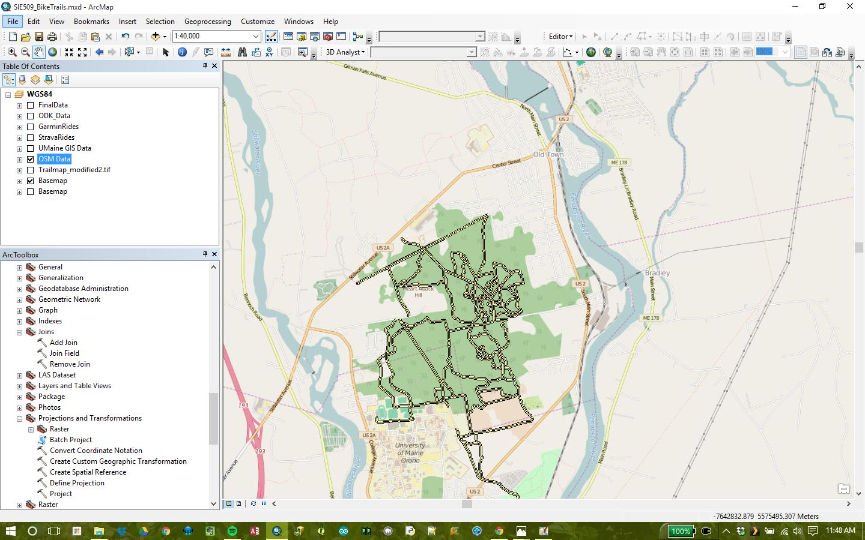
Step 2d: Other Data
Using OpenStreetMap background on final presentation and I thought I could include the existing data to verify what I already had
OSM layer in ArcGIS
Extracted OSM GPX data in ArcGIS
Notes:
Since I knew I was going to ultimately use the OpenStreetMap background as my base layer I decided to download the path data from their servers to compare that data with the data I had already collected.
The downloaded data was taken from the Java OpenStreetMap Editor and exported as a GPX.
The GPX was then imported into QGIS and exported as a shapefile to be added to my geodatabase.
Looking at the data, it appears that some of the data was taken from the University’s trail data and some was just digitized in.

Slide 14
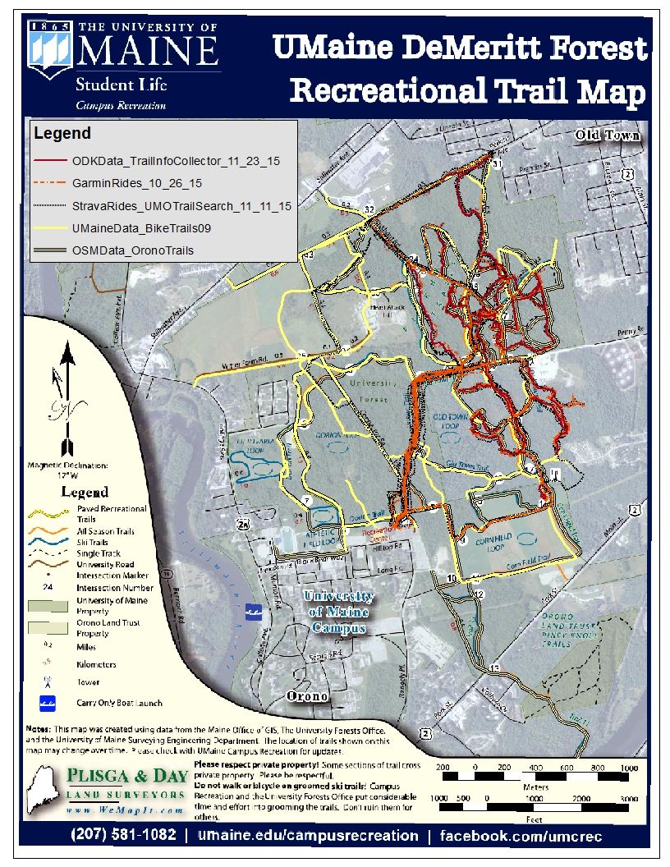
Step 3: Combine data
All data overlaid on PDF Trail Map
Combined all data
Generally the data looks consistent
Zoomed in there are a lot of inconsistencies
Spent a lot of time picking and choosing best tracks for each trail. Checking against aerial imagery seemed to be help a lot!
Biked Miles
Total: 51.8 miles collecting data
Single Track: 10.04 miles unique single tracks
Notes:
So now, I had a huge mess of data in my geodatabase, including: 1) ‘UMaineData_BikeTrails’, 2) ‘StravaRidesData’, 3) ‘GarminRides’, 4) ‘ODKData_TrailInfoCollector’, and 5) ‘OSMData_OronoTrails’.
The next step was to go through all of my datasets and pick the best paths for each trail by comparing it to the other sources and aerial imagery.
I could usually see parts of the trails in the aerial imagery so I could then use this to assess which path is the most accurate.
Generally, the ‘ODKData_TrailInfoCollector’ and ‘GarminRides’ datasets were the most accurate for the singletrack and main trails respectively.
I then made a feature dataset for my ‘FinalData’, which included the feature classes: 1) ‘FeatureData’, 2) ‘IntersectionData’, and 3) ‘TrailInfo’.
As I went through the data I would cut and paste the ‘best’ representative path for each trail in my ‘TrailInfo’ class, filling in the appropriate attributes for each feature.
At the end, I went through and double checked for topological errors and cleaned up any mistakes I made while digitizing.

Slide 15
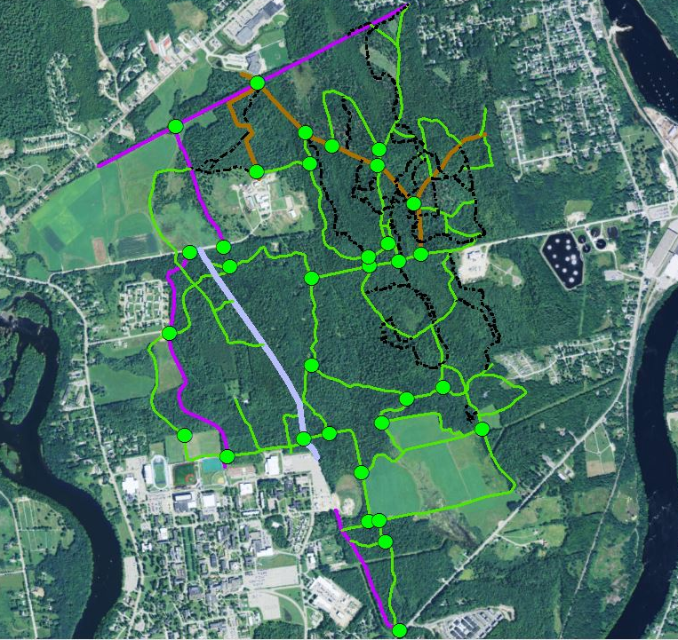
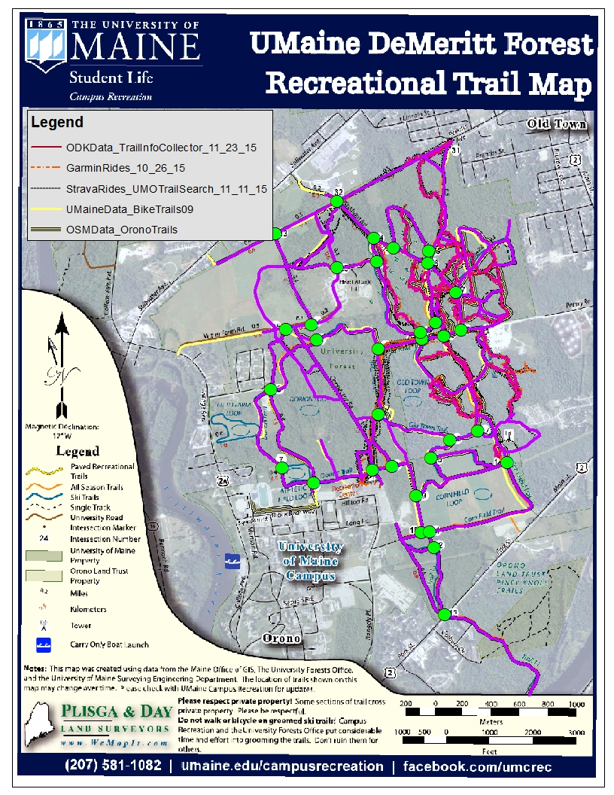
Step 3: Combine data
Merged data into datasets:
TrailInfo.shp (pink lines)
IntersectionData.shp (green dots)
TrailInfo.shp and IntersectionData.shp in ArcGIS
Notes:
On the left
The result was a nice clean trail system layer that had all of the trails in the portion of the DeMeritt Forest behind the University, including all of the attributes needed for my singletrack bike trails.
I started adding features to my ‘IntersectionData’ layer, using the UMaine DeMeritt Forest PDF as a baselayer.
I added all of the features on the PDF map to my dataset and entered all of the data I needed for each intersection.
This included adding a hyperlink column for the pictures of each intersection.
I was unable to get pictures for each intersection, but I downloaded some sample pictures that would be used to show the functionality of the system.
On the right
I did some preliminary styling to see how the data looked.

Slide 16
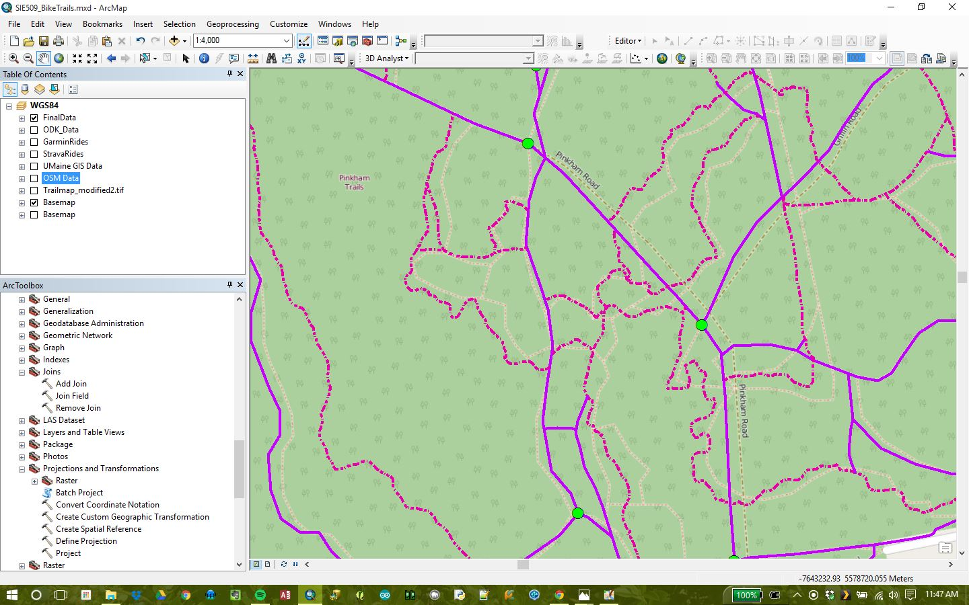
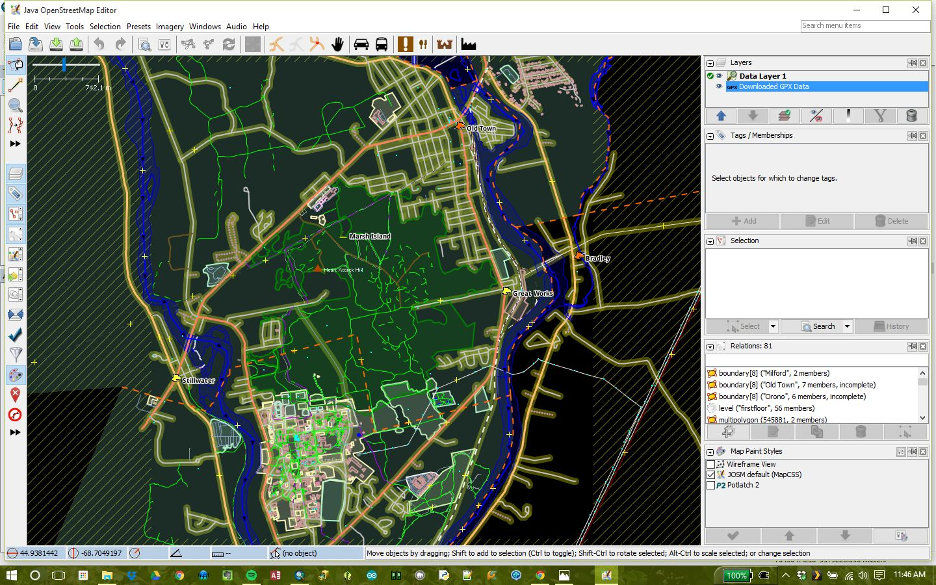
Step 4: Other Issues
Using OpenStreetMap background on final presentation
It will need to match up with my final data otherwise it will be confusing to look at!
OSM layer in ArcGIS below my data
Java OpenStreetMap Editor
Notes:
With all of my data complete, I decided to return back to the Java OpenStreeMap Editor program so I could make the changes needed to get the OSM Baselayer to match up with my trails.
First, I had to adjust my ‘TrailInfo’ layer in ArcMap to include some of the attributes that are required by OpenStreetMap in order to style paths correctly.
This required me digging through some documentation, namely the OpenStreetMap map features reference, to determine how to tag each path accordingly (http://wiki.openstreetmap.org/wiki/Map_Features).
I then exported the ‘TrailInfo’ layer as a shapefile that could be imported in Java OpenStreetMap Editor.
From here, I deleted all of the previous trails from the OSM servers and pasted my trails in their places. After replacing all of the old trails with the new trails I then had to go through all of the trails to make sure that all of the tag fields were properly populated from the shapefile.
Once everything was finalized I uploaded the changes to the OSM server.

Slide 17
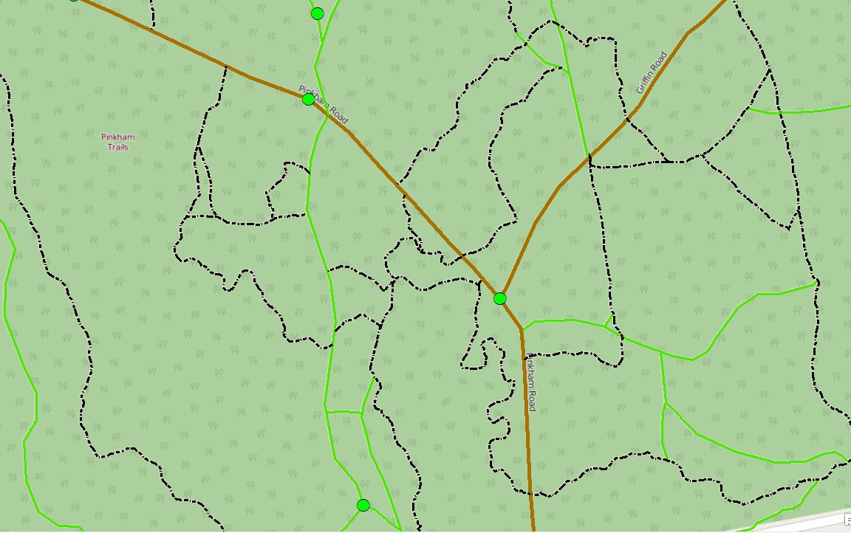
Step 4: Other Issues
Using OpenStreetMap background on final presentation
It will need to match up with my final data otherwise it will be confusing to look at!
CORRECTED OSM layer in ArcGIS below my data
Notes:
This resulted in an OSM baselayer that lined up perfectly with my TrailInfo layer.

Slide 18
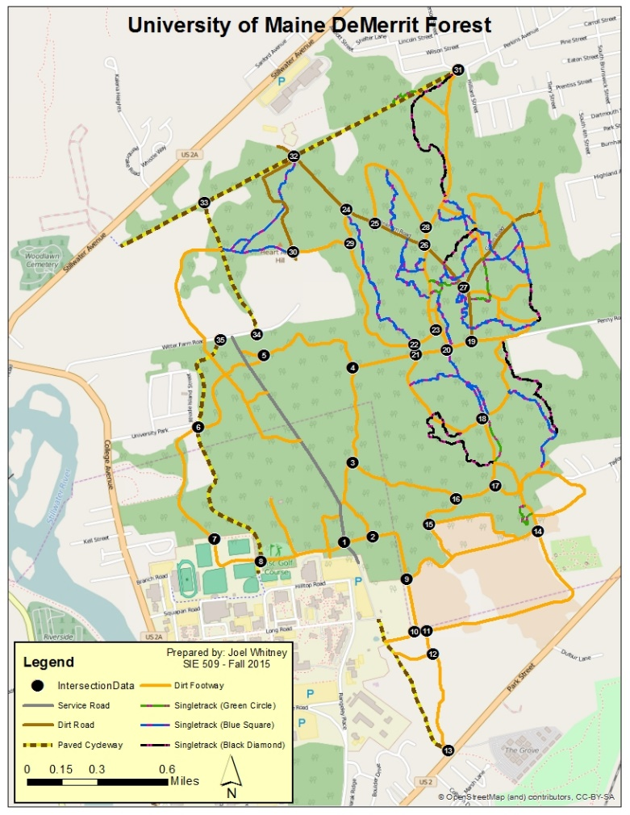
Step 5a: Final PDF Map
Final Georeferenced PDF
You can find location using geo-enabled PDF apps and a georeferenced PDF like the one here,
but cannot get:
Trail and intersection Info
Other trail systems
This map could easily be extendable to include other systems
High resolution map (fixed resolution)
Notes:
From here, I could style all of my trails appropriately in my ArcMap project to create my final output map.
I exported the PDF from ArcMap with the maintained georeference information so users could use the PDF for navigation on their phones.
As discussed earlier, this wouldn’t allow users to acquire information about the trails and it could not be extendable to other trail systems, so I had to start thinking about how I was going to get to the end result I wanted.

Slide 19
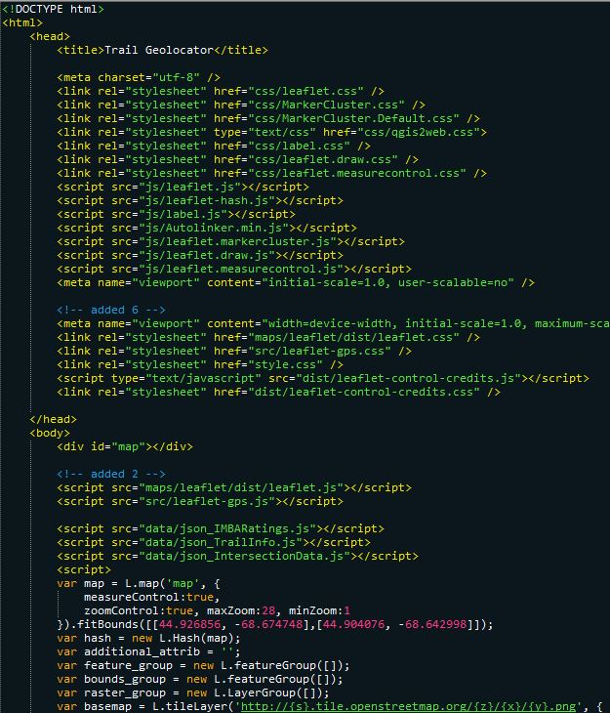
Step 5b: Final Web Map
Leaflet webmap
Final web map using Leaflet
Leaflet is an open source JavaScript library for interactive web maps
Lightweight, simple, and flexible
It is very similar to OpenLayers
Implemented through HTML/CSS
For my project I used:
Background: Web OSM Tile maps
Feature data: Converted .shps to GeoJSON files
Open standard format designed for simple geographic features
Website
http://joel-whitney.com/SIE509Final/TrailGeolocator.html
Notes:
I wanted to take my local trail information system and convert it to a relatively simple interactive web app that easily be used on a mobile device.
After some preliminary research early in the semester I determined that using Leaflet would be the best choice for my needs.
Leaflet is an open source JavaScript library designed for creating interactive web maps implemented through CSS and HTML.
Compared to some of its alternatives it is considered lightweight, simple and flexible.
It is very similar to OpenLayers, but is considered to be a more lightweight and easier to use alternative.
Early on in the semester I made a test page using the Leaflet library to see how practical using the library would be.
The idea was to build the basic framework with the basic functionality I needed with the OpenStreetMap baselayer.
Ultimately, I was happy with the result, and decided to continue using Leaflet.
Now that I had my data I could add my layers to the test map I made earlier.
I exported my ‘TrailInfo’ and ‘IntersectionData’ layers as shapefiles so I could import them into QGIS.
From QGIS, I exported the shapefiles as GeoJSON files that could then be easily used in the Leaflet map.
I then went into my HTML code and starting creating the styles that would be used on my web map.
Once I got my styles and map layout finalized I went back to add some more features.
The downside of the webmap is it really needs a continuous internet so I included a PDF export function within page
This button exports the georeferenced PDF map that I created as my final output.
This would be useful if I rider did not have a reliable internet connection, but still wanted the navigation functionality of the system.
The beauty of the Leaflet library is that it was relatively easy to populate the web map.
It took some HTML/CSS to get everything running and some minor JavaScript edits to Leaflet library to adjust things for my own personal taste.

Slide 20
Conclusions
Results:
Updated DeMeritt Forest Map
Web-based Singletrack Trail Information System & Geolocator
Improvements:
Make the system easier to add data from other systems
Iconic features that be used as landmarks and destinations
Trail news: updates, conditions, etc.
Notes:
So I had a lot of fun working on this project and the final results were an updated map of the DeMeritt Forest trails, including all of the new bike trails with their respective IMBA trail ratings and a full-featured web map that could be used for navigating the trail system and getting information for each trail.
Overall, I think the project was a success and I am very happy with the result.
Improvements to this system would include updating the intersection pictures to be of the actual intersections.
I’d also like to use the ‘Feature_collector.xml’ form I created to collect important landmarks and present them in the web map.
Furthermore, I think adding the ability to add updates on conditions of trail systems would be really useful for local riders.
Adding these additional features, as well as extending the system to include other trail networks, would require serious reconsideration of the design of the system as well as the layout of the web map.
But with that said, I will probably continue this project and make some changes so it will be easier to use in the Spring.

